Slide 1

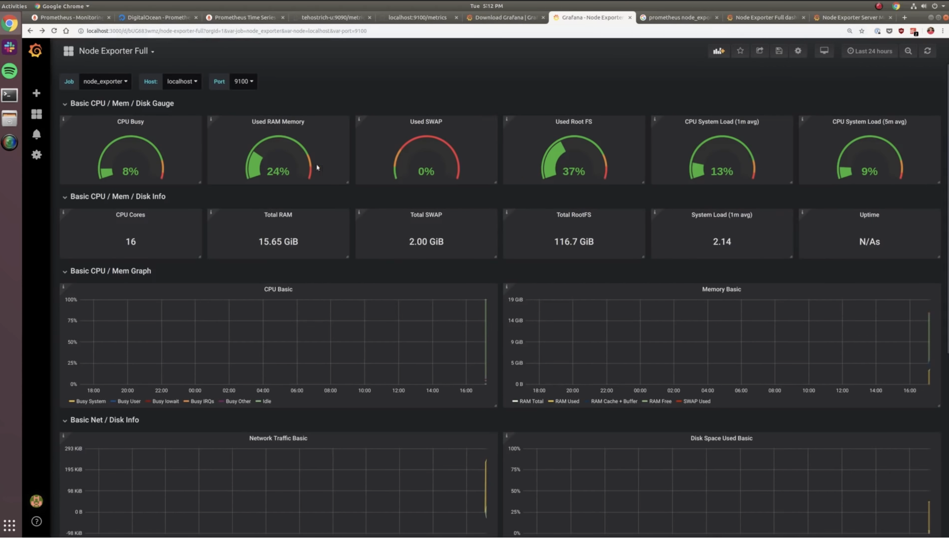
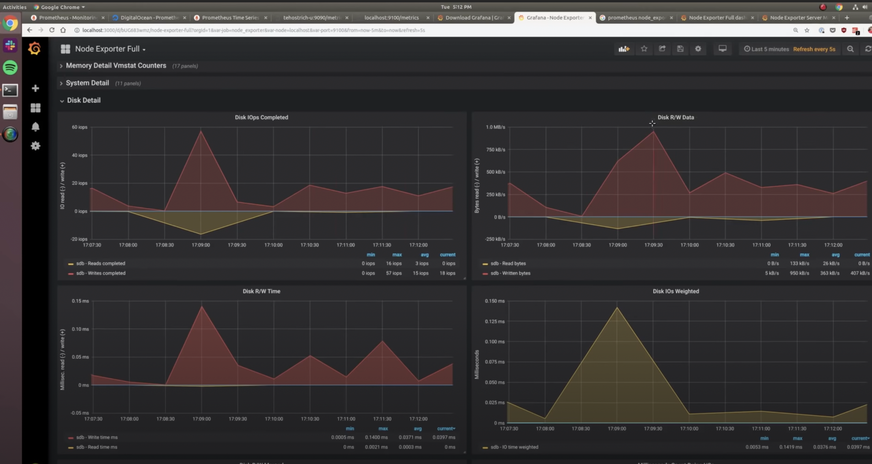

6. Practice Laboratory
Testing
Create dashboards
Apply changes to the infrastructure like
Create big files
Change the ram and CPU performance
Check the behavior of these in Grafana

